Slide 1


Harnessing Technology to Solve Local Problems
Ridzki Kramadibrata, Managing Director for Grab Indonesia
November 2016

Slide 2

Challenges & Opportunities
Over 250 million of population, with more than 5 megacities
Traffic congestions, costing IDR 25 trillion monetary value in a year
Unique & diverse market
Changes of transport policies
Growing middle class, open to sharing economy service
132.7 million internet users in 2016
Driven to be the biggest digital economy country in South East Asia by 2020
Notes:
Indonesia is a country full of potentials, yet with many real problems that we see as opportunities that we can address to drive Indonesia further.
These are several examples of the challenges and opportunities that makes Indonesia the biggest market for Grab.
Over 250 million of population, with more than 8 megacities
Traffic congestions, costing Rp 35 trillion monetary value in a year according to Jokowi earlier this year
Unique & diverse market
Changes of transport policies
Growing middle class, open to sharing economy service
132.7 million users, increasing 51.8% from 2014 (APJII, 2016)
Driven to be the biggest digital economy country in South East Asia by 2020

Slide 3
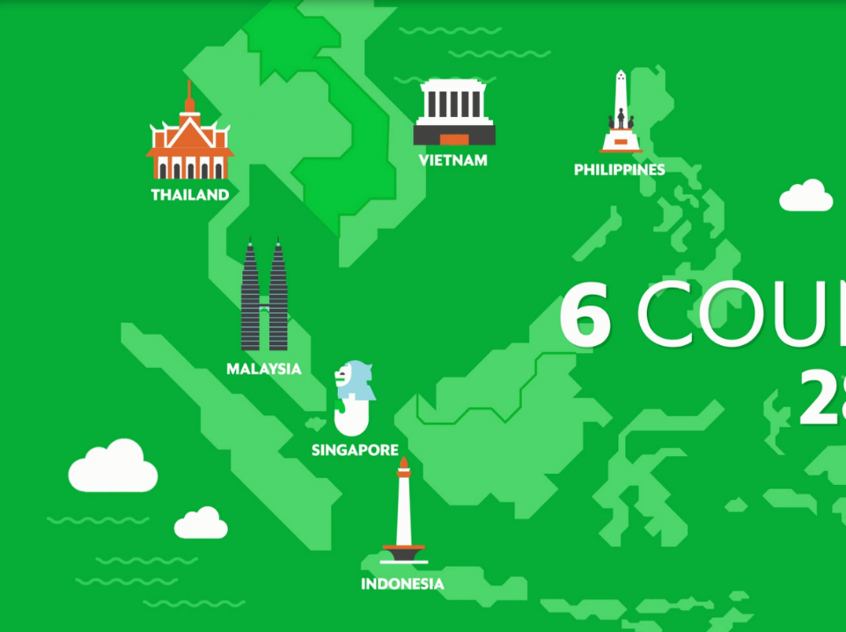
Solving Local
Problems
Notes:
At Grab, we always start with very real and socially relevant problems to solve
We are winning in SEA because of our hyperlocal strategy – meaning we take a tailored approach to every city we operate in.
We have local teams in every country, Grab in Indonesia is run by Indonesians and so on.
We knew bikes were the preferred transport option in Indonesia, so we introduced bikes.
We knew cash was how people wanted to pay and be paid, so we launched with cash payments on day 1. We made sure our bike drivers are paid in cash everyday – so that they can cover their daily costs.
We understand that the recently announced odd-even number policy might become a challenge for our driver partners and passenger to get a ride, and we would like to support the government to enforce the policy, thus we add a new algorithm to add additional filtering to match the license plate number based on the date, hours, and location.

Slide 4
Mission
Providing the Safest Transportation in SEA
Making Transportation Accessible for All
Improving Lives of Our Partners
Notes:
For the first time in history, a home-grown SEA tech company is poised to help shape the future of SEA. We’re all really proud of that. For our drivers we stand for opportunity. Opportunity to make a better income to spend on education, housing, healthcare. For our customers, the biggest thing is time. Because of the efficiencies we create, people have more time in the day. And for the cities we operate in, we stand for less congestion, better traffic flow and we’re nurturing the engineering talent in SEA and around the world. In doing all of this, we are leveraging world-class technology and pioneering our region’s internet ecosystem.
As a company, we have truly evolved and grown over the years. Going forward, we are focused on:
Creating the safest transport platform:
There is no compromise to this because safety is at our core.
2) Making transportation accessible to all:
In Singapore, how can we support the transition into a car-lite society through our platform?
How can we continue to support the public sector to make Singapore’s transport system even more efficient for Singaporeans?
3) Improving the lives of our partners
How can we continue to help drivers earn more income in a sustainable manner?
These are big goals. But they can be solved with people who have the same passion to make a difference and with great technology.

Slide 5











Grab Milestone
A Full Suite of Transport Options
Indonesia 1H 2016 update
>250x
300%
50%
GROWTH
SINCE MID-2015
GROWTH YTD
SUBSIDIES
REDUCTION
New Complementary Services
3
6
32
COUNTRIES
CITIES
R&D CENTERS
500k
24
DRIVERS
MILLION DEVICES
Notes:
Indonesia is Grab’s largest market – it’s our only market that has almost the full suite of Grab services that you see here.
We offer the most comprehensive portfolio of transportation services in SE Asia
Services that cater to every transport need, preference and price-point
1 in 4 of our customers here use more than one service – if you’re in a hurry in the morning, you can take GrabBike; if it rains, you can take GrabCar.
Our GrabCar and GrabBike services in Indonesia have grown >250x, since mid-2015.
In 2016, GrabBike has grown 300% Year-to-Date in Indonesia, while reducing bike subsidies per completed ride by 50%.
Grab has grown from nothing to the #1 ride-hailing app in SEA.

Slide 6


Commitment in Technology
Notes:
Since technology is our core business. We invest heavily on technology and ensuring that we will be able to leverage technology to achieve our key missions.
In building the best and most widely used app, we now have three tech centers – our largest here in Singapore, in Beijing and in Seattle. Our engineers love that they’re making an impact on people’s lives in SEA.

Slide 7

Harnessing the power of technology
Notes:
How do we achieve all of this? How does Grab drive changes the lives of the people that we touch?
The key is technology.

Slide 8
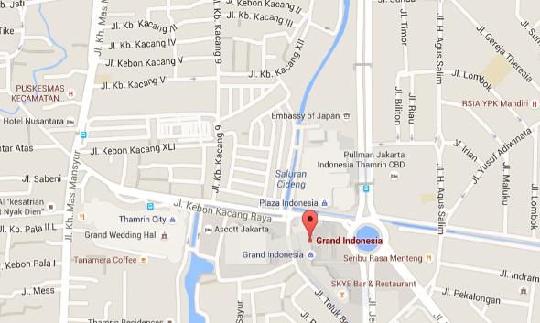

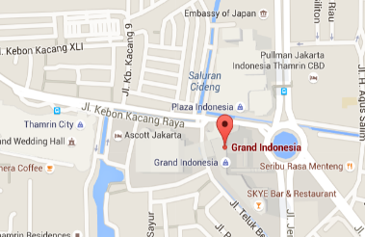



Taking data-driven approach to increase productivity
A
Many shoppers waiting to go home at Grand Indonesia
C
Tariff is adjusted in real-time to motivate drivers to go where the demand is high
B
Grab mobilizes drivers to head to the demand hotspots
1.5x
Notes:
Data analytics is the core engine for Grab.
I believe some of our best insights come from observing and listening to our passengers, but data and technology also play an important role in our business.
The roads and rules in Indonesia are also constantly changing - and we regularly update our backend to keep up with that
For example, we clean up our Point of Interests or POIs, so that passengers can get a more accurate drop off and pick up.
Here’s a quick illustration of our data analytics.
Say it’s after dinner time at Grand Indonesia and people are trying to book rides to get home.
We’re able to predict when there is high demand – based on real-time bookings and historical analysis – and notify our drivers to go there.

Slide 9
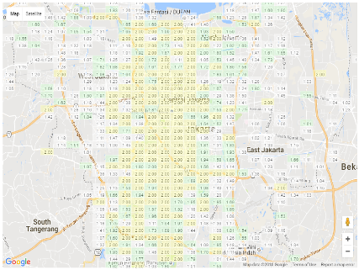
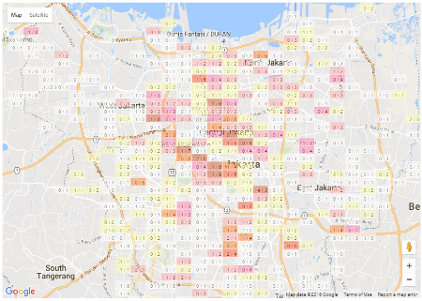
Taking data-driven approach to increase productivity
Monday morning
Friday evening
*Sample charts for illustration purposes
Notes:
We do this in real-time
Here’s a look at our demand heat maps in Jakarta
On the left, on Monday morning, people are getting into work – a little surprising as you’d expect it to be peak hour, but we know that many people try to avoid the traffic by going into work at different times
On the right, on a Friday evening after work, there are hot spots closer to and within the centre of Jakarta. Not surprising as people hang out with their friends in the city
These heatmaps help us track demand in real-time. We know when there are unforeseen circumstances like bad weather or public transport breakdowns – sometimes even before the news is out!
And we can send our drivers to areas where there are more passengers booking rides.
This is just one example of the data we track.
We use data to provide more accurate ETAs – or estimated times of arrival.
Bikes can easily overtake cars in heavy traffic. So we analyse the routes and timings for bikes and cars – to reflect their unique ETAs

Slide 10

Driving Positive Impacts to Communities with Technology
Notes:
One of the key driving force for many of us who is at Grab is that we believe that Grab has touched lives of many people, and change their lives to be better.
And, we have seen first hand on how Grab has affected the lives of our driver partners and their families.

Slide 11
Driving Forward
Digital Penetration
Enabling driver partners to embrace digital by:
Enabling them to own smartphone with financing scheme
Empowerment through trainings/workshops
Improving productivity with technology

Slide 12
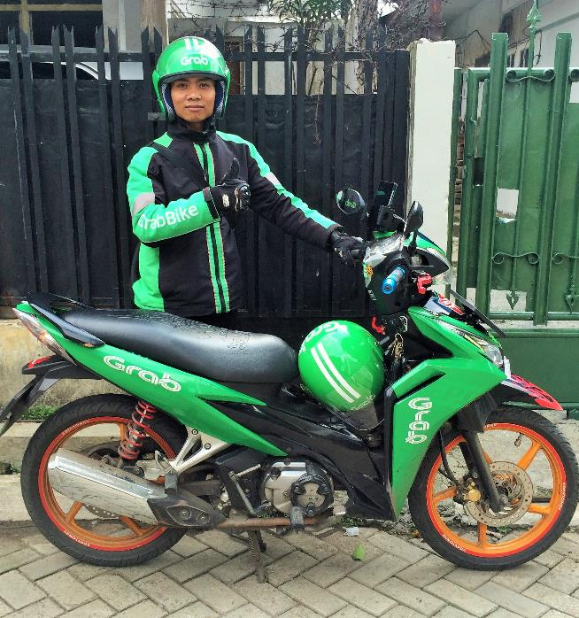
Improving digital literacy
This is Rudianto, one of GrabBike bikers in Jakarta
Previously, he worked as a construction worker and 3-in-1 jockey. Doesn’t even have a smartphone.
Now, he has mastered mobile banking, communicate with his family and friends with various apps, and use various Google apps for self-empowerment.
Notes:
Grab is stimulating the growth of digital literacy. I’ve personally seen our drivers starting to use the internet or mobile apps when they are signing up to join Grab. It has changed their lives – with the Grab app, Indonesian drivers have over 70% increase in average daily incomes.
Now, connectivity and digital technology have become a part of their daily lives, not just to bid for a job on our Grab platform, but also to connect with their families, delve in e-commerce, or pay bills with e-banking.
Let me show you some example <click>
This is Rudianto, one of GrabBike biker in Jakarta
Previously, he worked as a construction worker and 3-in-1 jockey. Doesn’t even have a smartphone.
Now, he has mastered mobile banking, communicate with his family and friends with various apps, and use various Google apps for self-empowerment.

Slide 13
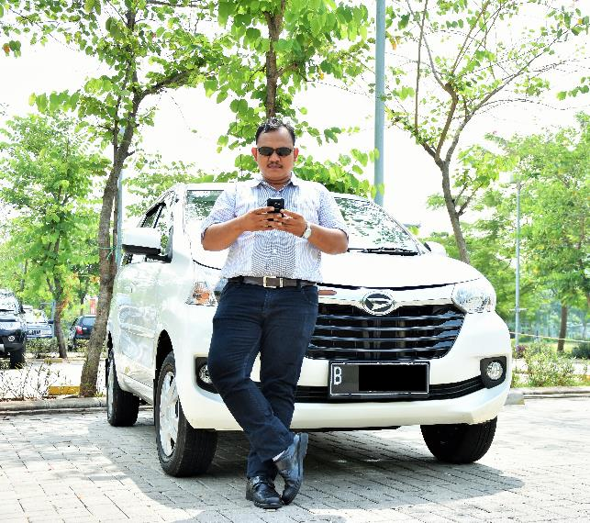
Improving our partners livelihood
This is Roekhan, one of GrabCar drivers in Jakarta
Spent more than 8 years as a driver for a conventional taxi company, with barely enough income for a living.
Now, he owns two cars, has bought a house, and enough income to support his family.
Notes:
Happy drivers are critical to our business. It’s really important for us to understand what matters to drivers and what doesn’t. A driver survey showed that drivers in Indonesia enjoyed over 70% increase in average daily incomes, with 98% of drivers reporting more bookings with Grab. 98% of drivers felt that Grab improved safety, and 95% of drivers felt more job satisfaction and security.
We leverage technology to ensure our driver partners gets more job, efficiently. And this drive the income and livelihood of our partners that affected the economic cycle of him and his family.
This is a small example <click>
This is Roekhan, one of GrabCar driver in Jakarta
Spent more than 8 years as a driver for a conventional taxi company, with barely enough income for a living.
Now, he owns two cars, has bought a house, and enough income to support his family

Slide 14
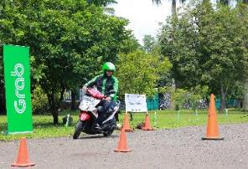
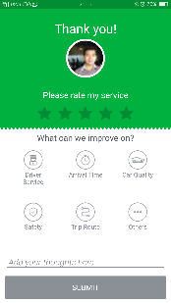
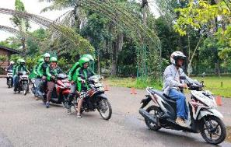
Telematics to encourage safer driving
Speeding monitoring system based on driver GPS data
Reminders sent to drivers who speed
35% decrease in speeding by GrabBike drivers in Indonesia
100% licensed, compulsory defensive riding training
In-app driver rating
Notes:
We also use data to encourage safer driving on Indonesian roads.
On a serious note, the motorcycle accident rate in Indonesia is higher than the SEA average. Indonesia loses among 3% of GDP in economic losses every year because of road accidents.
This is where data and technology can help.
We use telematics to encourage safer driving. We have hundreds of thousands of driver data points everyday.
We have a speeding monitoring system and send reminders to drivers who speed – to correct their driving behaviour
In fact, there’s a 35% decrease in speeding by GrabBike drivers in Indonesia because of this.
Of course we also have offline safety measures, such as a strict screening process – 100% of our bikers are licenced – and defensive riding training.
The Grab app also features the Share My Ride feature, and ratings for drivers. We only keep the best rated drivers.

Slide 15

Thank you.

